Slide 1





Solar Angle Calculator
DAYANANDA SAGAR COLLEGE OF ENGINEERING
An Autonomous Institute Affiliated to VTU, Approved by AICTE & UGC
Accredited by National Assessment and Accreditation Council (NAAC) with ‘A’ Grade
Department of Computer Science and Business Systems
2
0
2
3
2nd Semester Mini-Project Presentation
Date: 17th September 2023
Time: 8:30 AM onwards
Janardhan Patil -1DS22CB025
Harsh Raj -1DS22CB024
Gagan Handral -1DS22CB023
Avinash Kumar-1DS22CB016
Under the Guidance of
Dr. Dattatreya
Professor / Assistant Professor,
Head of Department of CSBS,
Dayananda Sagar College Of Engineering, Bengaluru

Slide 2
Organization of the Presentation
2
0
2
3
Introduction
Literature Survey
Problem Statement
Objectives of the proposed Mini project
Proposed Methodology
Expected Outcome
Advantages and Limitations
References

Slide 3
2
0
2
3
Introduction
With rise of population, it is expected in the near future, that the demand for energy will grow faster than the finding out of new available fossil resources.
There is a need for finding an alternative source of energy.
The international scientific community has devoted intense efforts to develop and promote Solar Energy due to availability without any limit.
In this project a solar panel installation guide for efficiency maximization referring solar energy production is developed.
The solution developed is to figure out the finest position and direction angle of a solar panel to capture maximum sunlight and give the optimal results all year round.

Slide 4
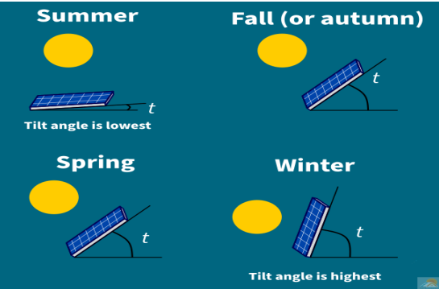
Illustration
2
0
2
3

Slide 5
Literature Survey
2
0
2
3
Haixiang Zang [2016] determined the optimal tilt angle of solar collectors for different climates of China. The paper suggested a simple and universal method to obtain the optimum tilt angles by estimating the mean global solar radiation on tilted surfaces facing directly towards the equator.
Kaveri Markam [2011] did the estimation of optimal tilt angle for solar photovoltaic installations in India. Optimization of tilt angle ensures the maximum energy generation, thereby reducing the cost of power generation. This paper attempts to estimate the optimal tilt angle of PV for different locations of India using various simulation software like RETSCREEN, PVSYST and NREL SAM. The yearly optimal angle obtained are having variation of +2ᵒ to +3ᵒ from the latitude of the location.

Slide 6
Problem Statement
2
0
2
3
From the past two decades it is observed that, energy consumption is increased by 50 per cent, with the bulk of the demand coming from developing countries.
Oil, coal and gas, which are Fossil Fuels, together account for the majority of global primary energy consumption. There is a need for finding an alternative source of energy.
Solar Energy is considered to be the best contender to tackle the energy needs of population.
However, on the consumer level the knowledge of different types of solar panels and the installation methodology is over whelming for a person.
The maintenance and improvement activity poses another challenge to the consumers.

Slide 7
2
0
2
3
Objectives of the Mini project
Our primary objective is to maximize the output coming from the solar panels by obtaining the optimum tilt angle for the solar panels.
To develop a module for computing the optimum solar panel tilt angle.
To design a module which provides the static data of the average tilt angle of the five major cities of India i.e., Delhi, Mumbai, Bengaluru, Kolkata, Chennai.
To design a module which also asks the user to prompt the latitude of your location which will further provide the tilt angle for different seasons at that particular location.

Slide 8
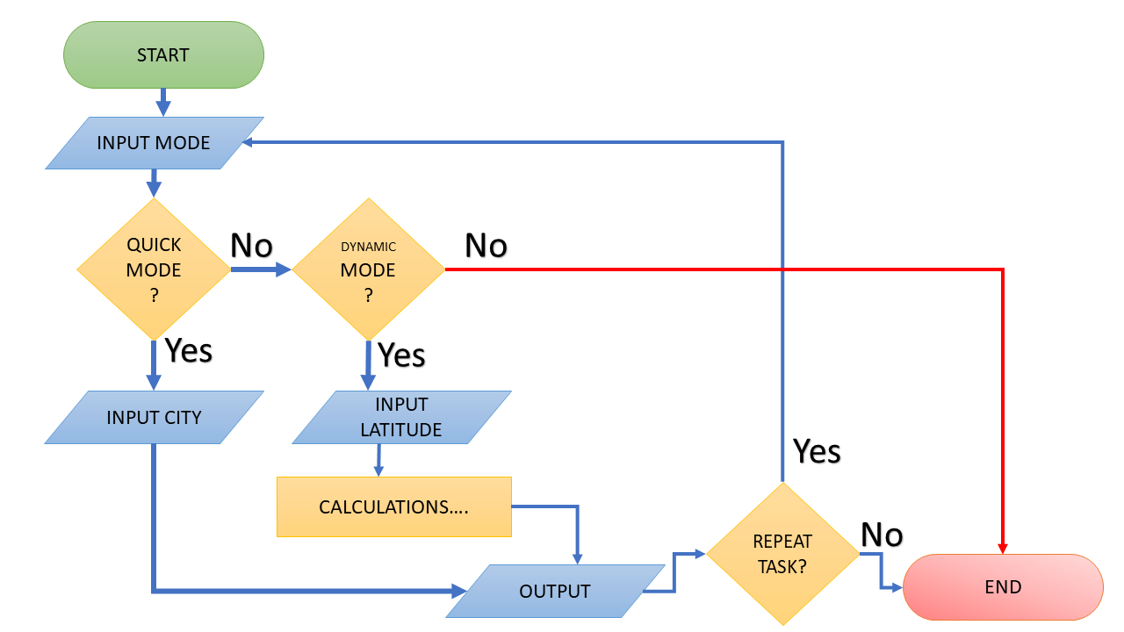
2
0
2
3
Flowchart

Slide 9
Proposed Methodology
2
0
2
3
With this project our team aims to provide guidance at the root level (layman’s level) for installation of solar panels at the consumer level as well as to an industry level.
The Program is coded in C++ Language with the concepts of OOP and Methods. The Program of our project consists of two modes:
(i) QUICK MODE
(ii) DYNAMC MODE

Slide 10
2
0
2
3
QUICK MODE
This mode as the name suggests comes in handy when a quick intention is required.
It contains a list of pre-updated values for the whole year on the monthly basis for some selected cities. This list also contains an averaged-out value on the season basis.
All the values are represented in degrees and the fact, keeping in mind, that all panels should be facing south direction on the basis of India being in the Northern Hemisphere.

Slide 11
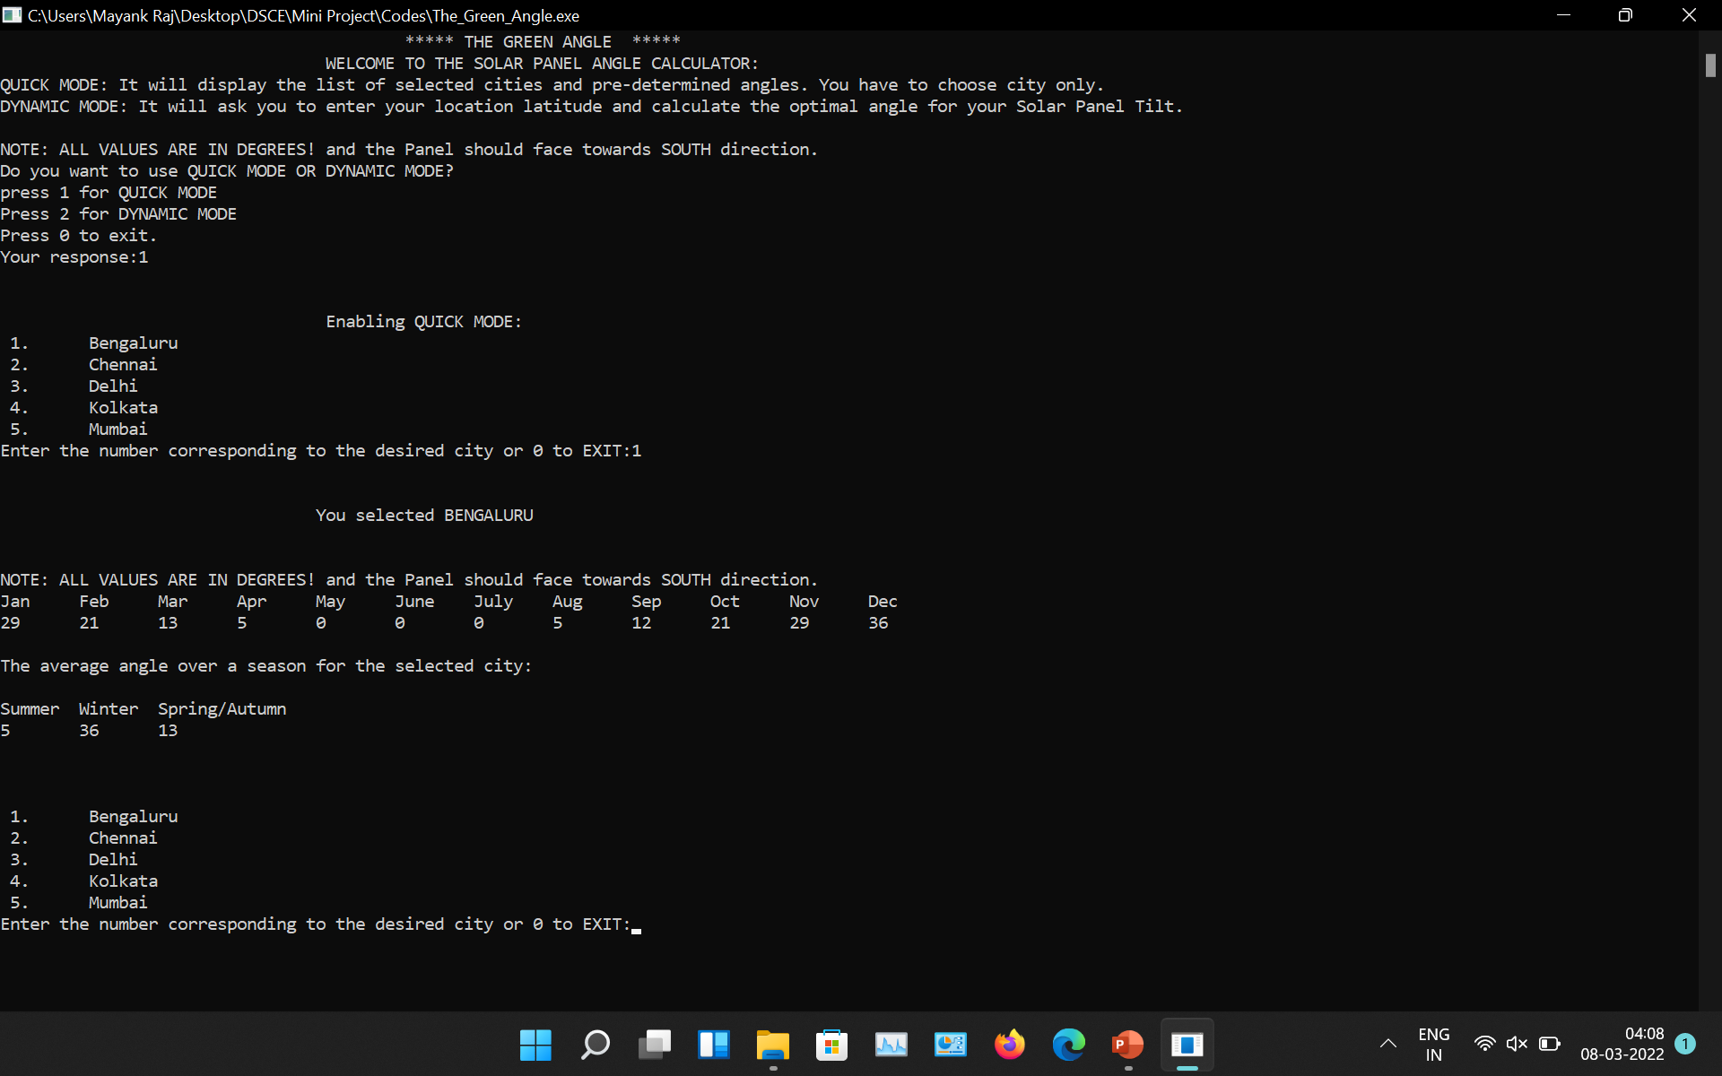
2
0
2
3
Quick Mode (Illustration)

Slide 12
2
0
2
3
DYNAMIC MODE
This mode is the core of our project.
In this mode the program prompts the user to enter the latitude of his/her location and then with the help of developed mathematical models and algorithms our program calculates the Optimal Solar Tilt Angle for the solar panel at which to be installed.
The values are represented in degrees and the fact, keeping in mind, that all panels should be facing south direction on the basis of India being in the Northern Hemisphere.

Slide 13
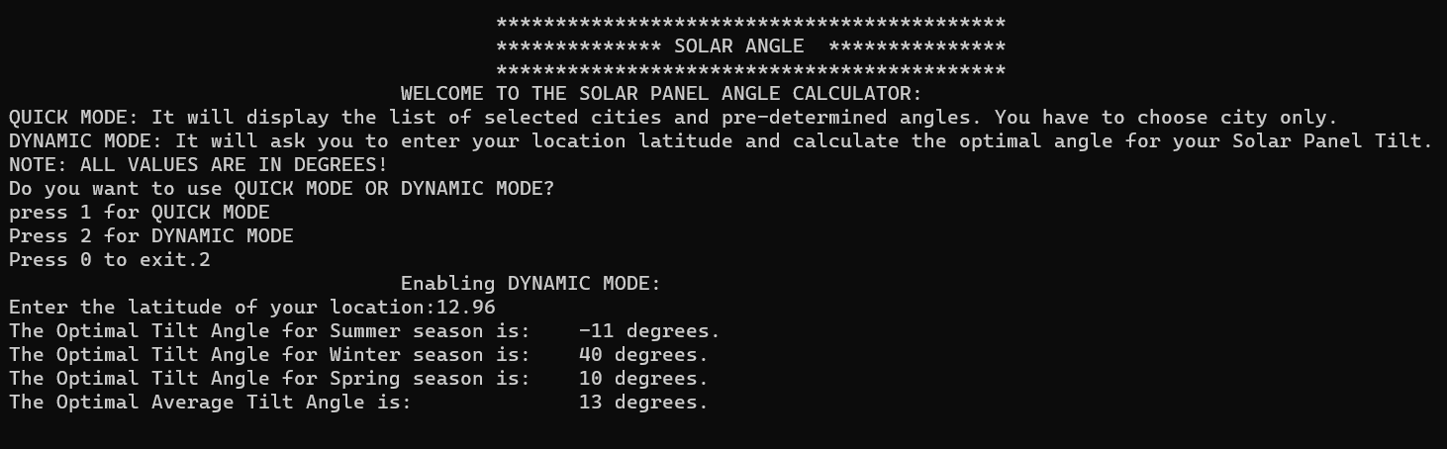
2
0
2
3
Dynamic Mode (Illustration)

Slide 14
Expected Outcome
2
0
2
3
On successful trials our program is giving a relevant results.
Both modes of our program are running well and are giving relevant and significant results.
The console will give as the optimum solar panel tilt angle according to the geographical location entered, for different seasons and months of the year which will help in maximizing the solar power generation by ensuring the maximum sunlight to fall on the solar panel

Slide 15
2
0
2
3
Bengaluru
Dayananda Sagar Institutes

Slide 16
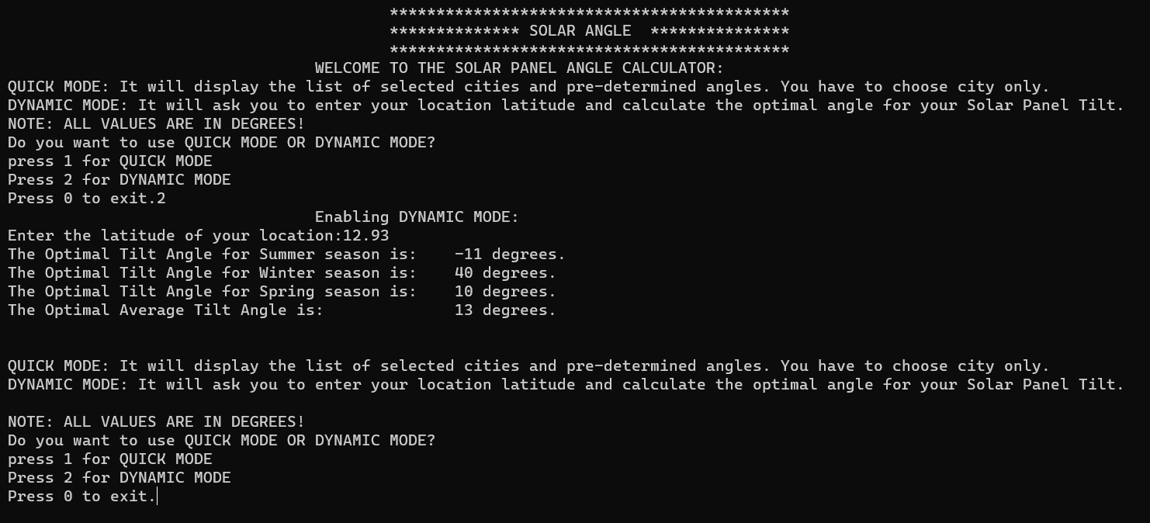
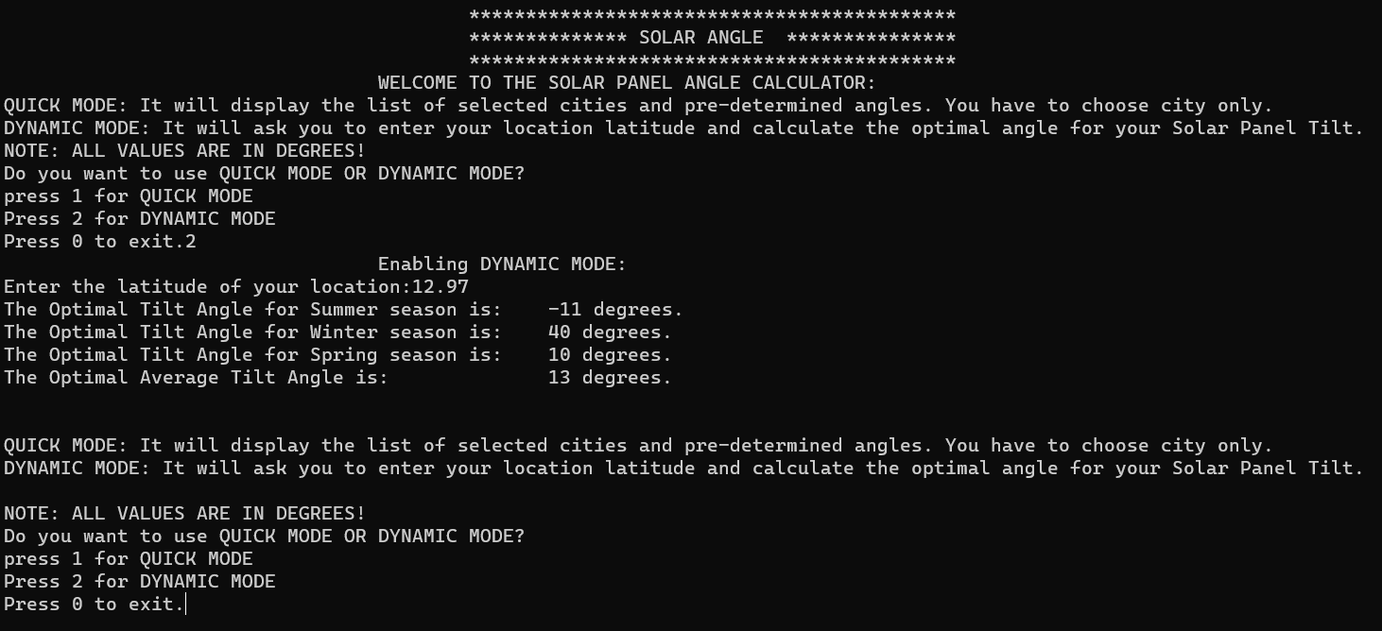
Jayanagar
2
0
2
3
Majestic

Slide 17
Advantages and Limitations
2
0
2
3
Advantages:
Energy Efficiency : Significant energy increment in power generation through automatic adjustment of solar panel
Cost Savings: less solar panel is required to produce the same energy
Environmental Sustainability: manufacturing of solar panel requires use of heavy metal which is not good for environment so if less solar panel is required less solar panel will be manufactured hence leading to less use of heavy metal.
Improved Efficiency: Properly tilted panels are more efficient, converting a higher percentage of sunlight into electricity. This can lead to a higher return on investment (ROI) for solar projects.
Limitations
User has to enter the latitude of the City rather than city name directly, which adds a extra burden of work on user of finding the latitude of the City

Slide 18
References
2
0
2
3
https://sinovoltaics.com/learning-center/system-design/solar-panel-angle-tilt-calculation/
Khan, N., Mariun, Z., Saleem, N., Abas, N. “Fossil Fuels, New Energy Sources and the Great Energy Crisis”. Renewable and Sustainable Energy Rev (2007).
João M. G. Figueiredo1, Intelligent Sun-Tracking System for Efficiency Maximization of Photovoltaic Energy .
https://spectrum.ieee.org/mobile-robots-turn-solar-panels-to-follow-thesun

Slide 19
2
0
2
3
Thank you

